Slide 1

Electrical Engineer Co-op Presentation Northwood E&I
David Emelu
UVIC – 2nd Year Electrical Engineering
January 2024 – August 2024
Supervisors: Savio D’Silva, Denni Thompson and Ryan Swanson
Manager: Umunna Uwom

Slide 2
Outline
Supplementary
Project Involvements
Project Descriptions
Methodology
Results
Benefit to the mill
Workshops

Slide 3
Projects
MCC/MCC Room Drawing Audits
‘A’ Digestor Provox Migration Project
Distribution and Precipitator Transformer Summary Report
B Diffuser Hydraulic bypass using Local Selector Switch Installation and PLC Rewiring
VFD migration for B Bleach 50% Peroxide Pump and R8 93% H2S04 Generator

Slide 4
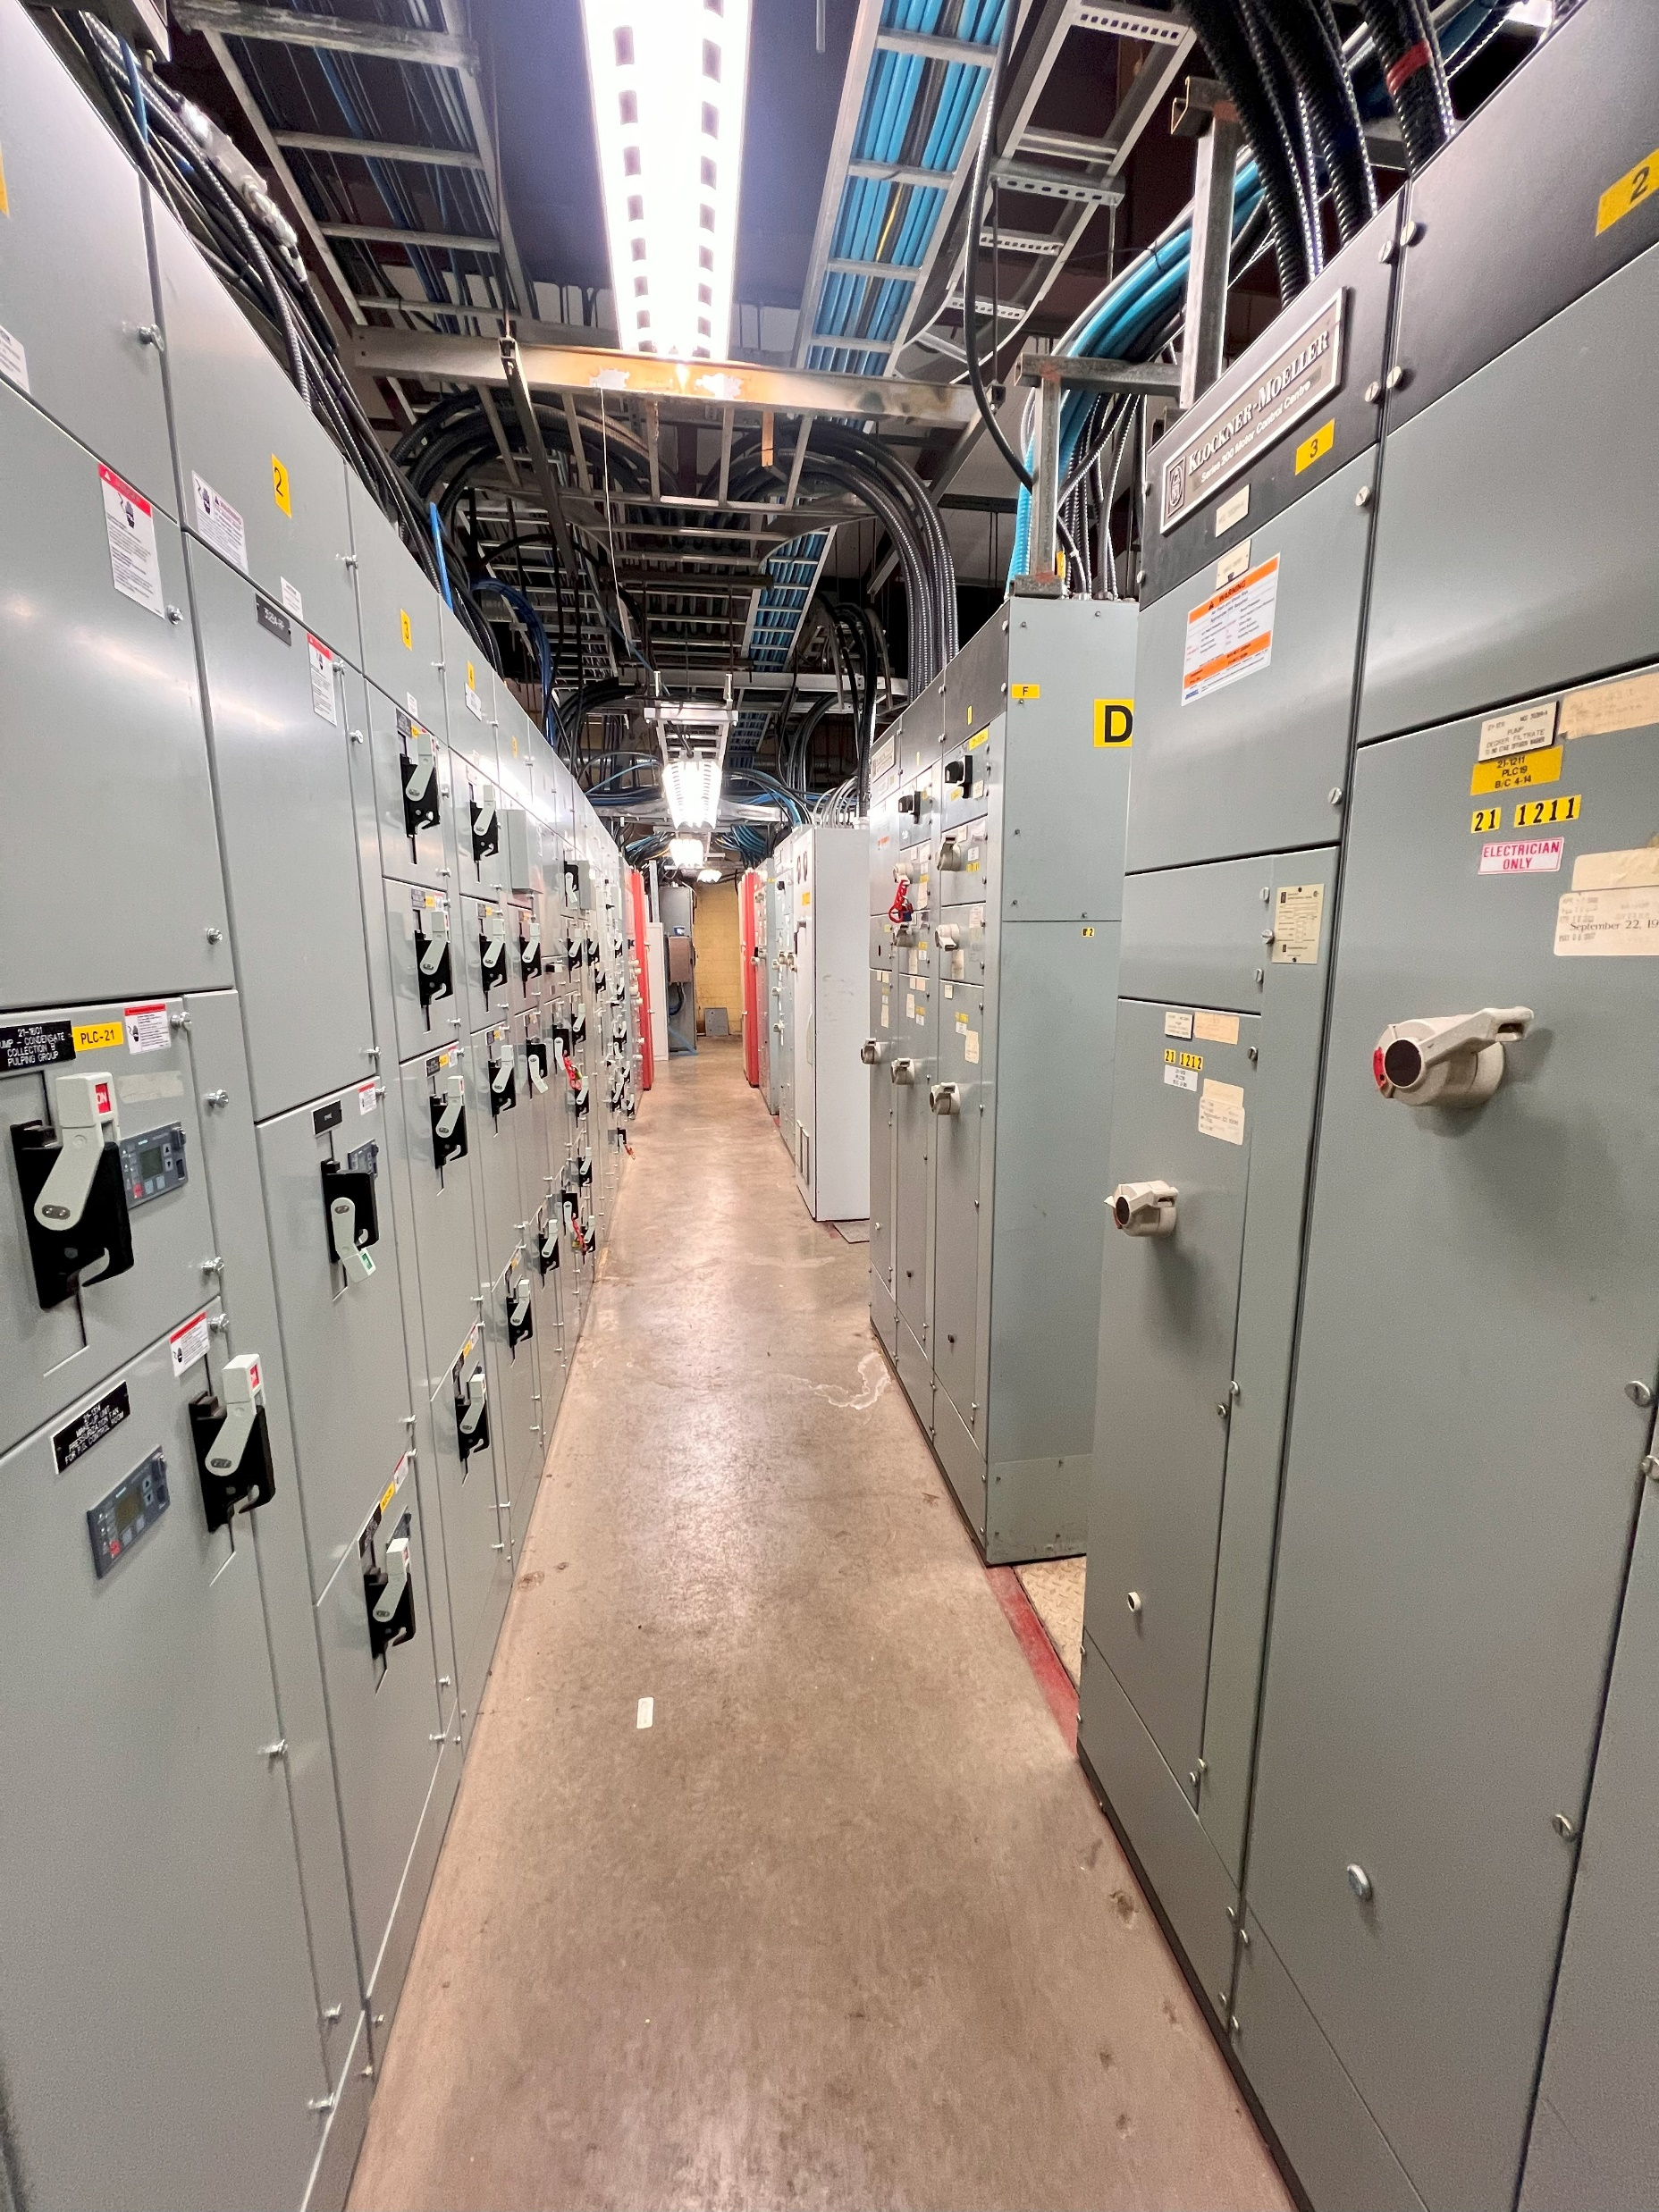
MCC/MCC Room Drawing Audits
Scope of work
Audit MCC/MCC Room layout
Update asset list in each MCC/MCC Room
Identify undocumented power cross-feed and create a cable block diagram

Slide 5
MCC/MCC Room Drawing Audits - Methodology
1
Assembled a binder containing all MCC/MCC room layouts drawings for easy reference.
2
Conducted thorough field checks to identify discrepancies and verify asset statuses.
3
Evaluated changes and prepared revised drawings for drafting..
4
Mapped existing power cross-ties on a cable block diagram to identify cross-feed locations for emergency power.

Slide 6
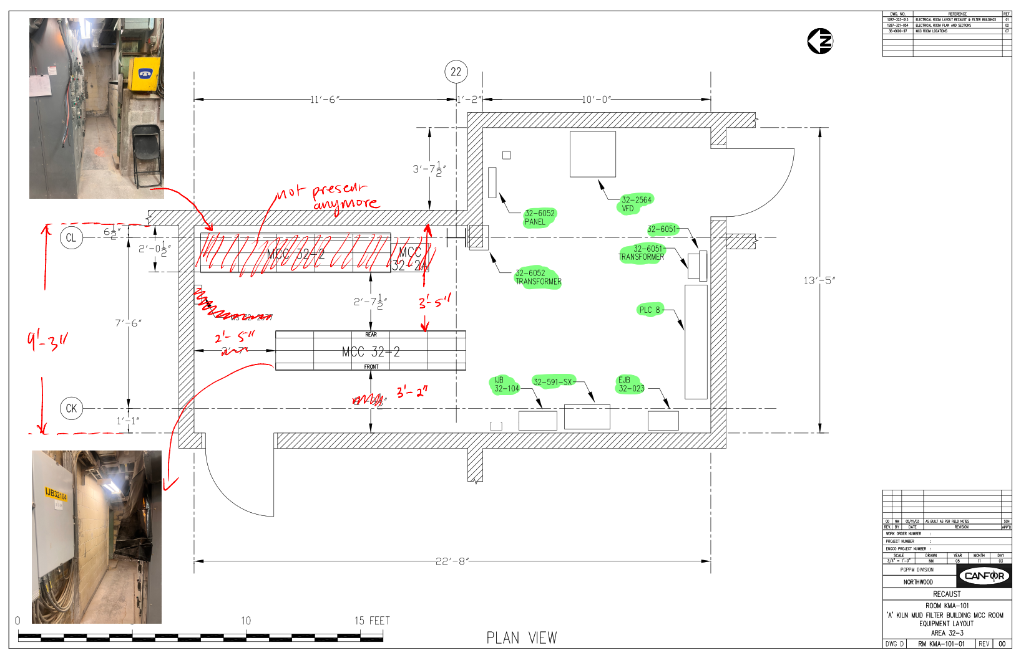
MCC/MCC Room Drawing Audits
‘A’ KILN MCC ROOM AUDIT

Slide 7
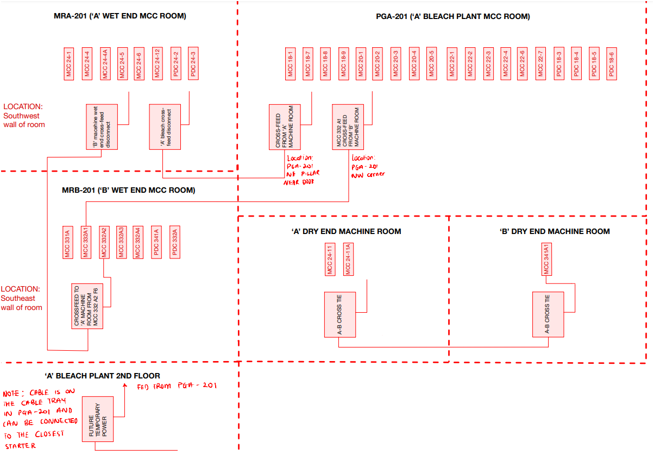
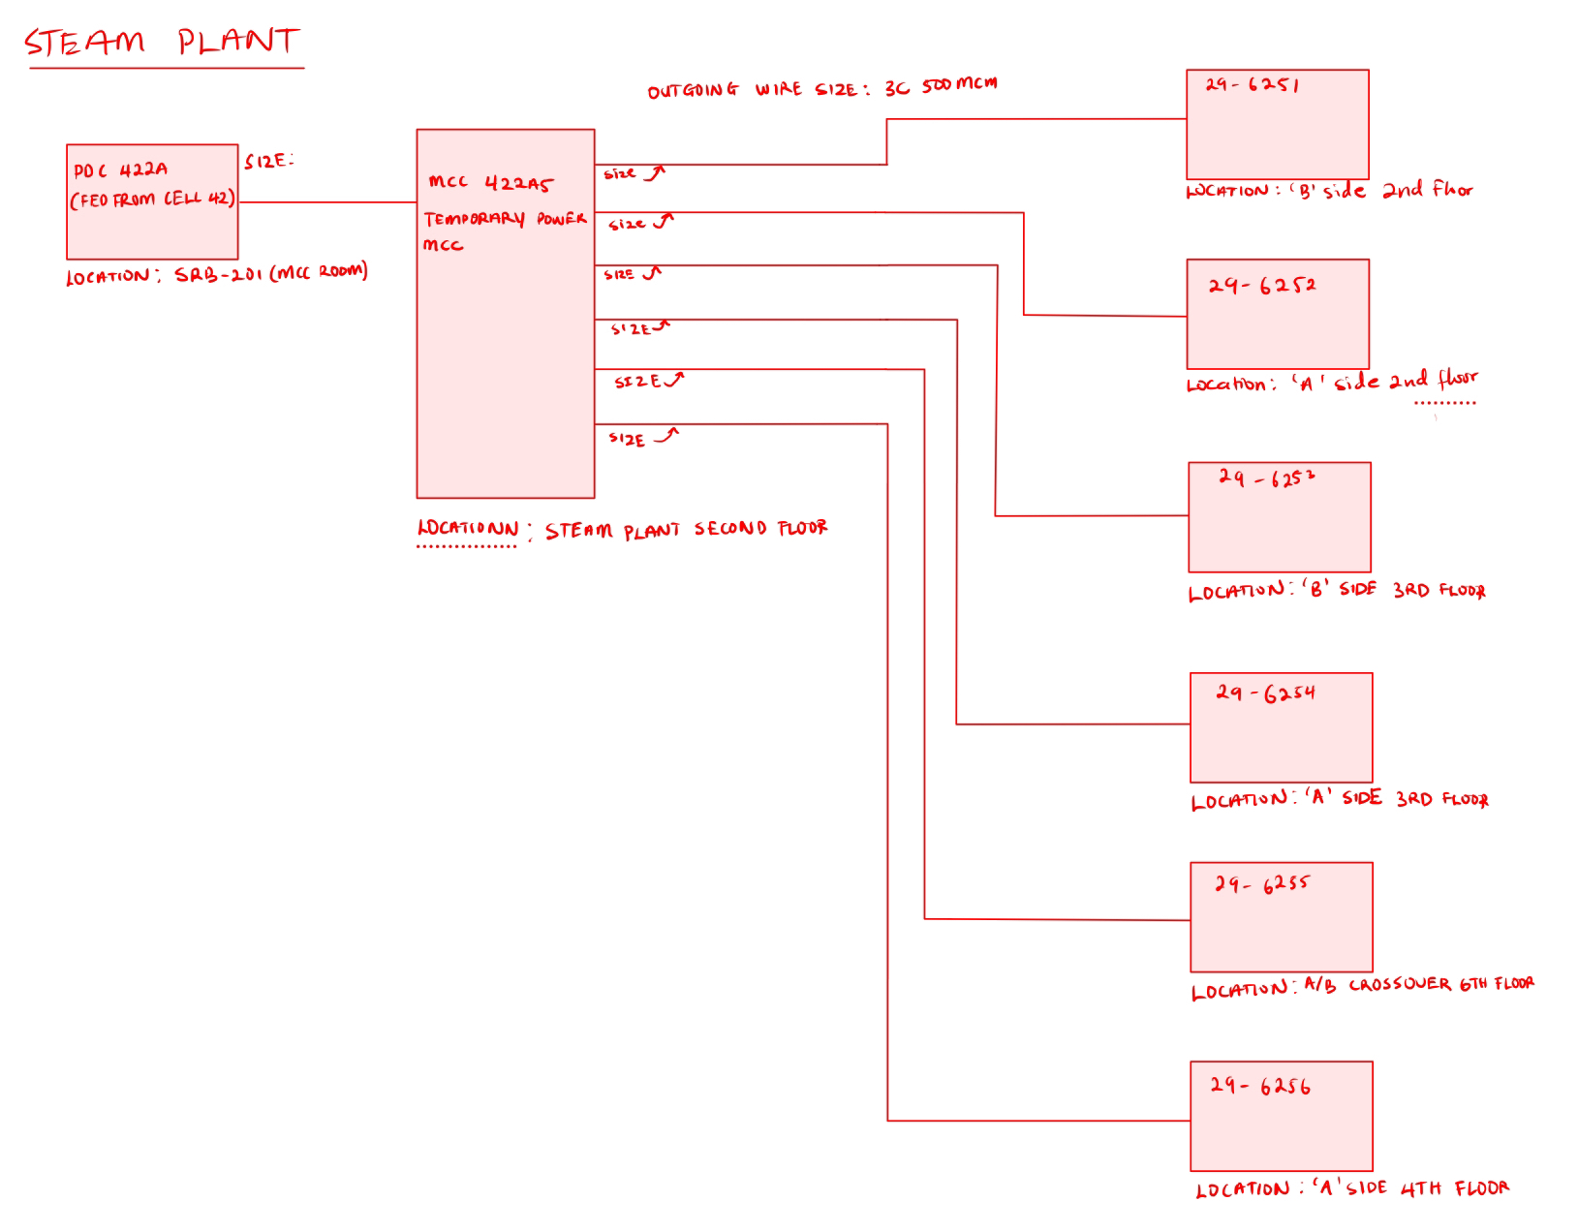
CROSS FEED
Fiber line area
Steam plant area

Slide 8
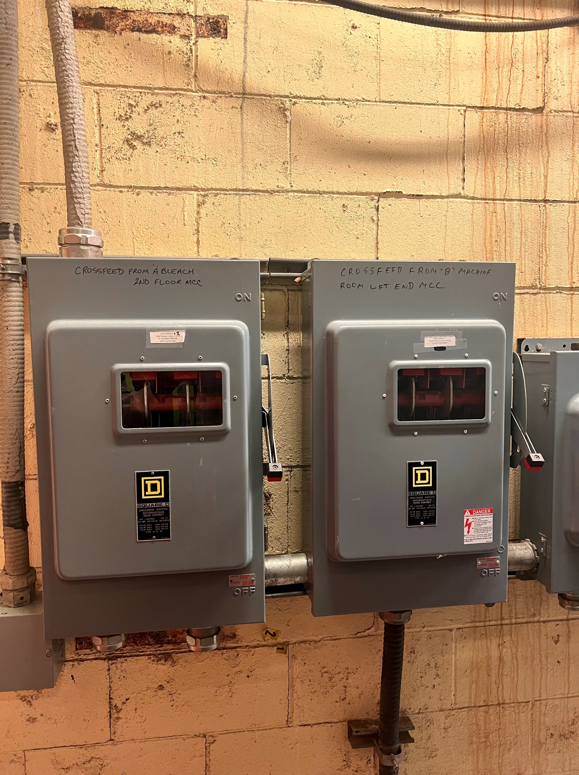
CROSS FEED
Importance of documenting power cross-feeds locations
Safety: Without proper documentation, it is easy to make mistakes during maintenance or emergency situations, which can lead to accidents or equipment damage
Lockout Planning: Documenting cross-feed locations help in knowing the exact power sources and connections which helps in isolating specific equipment safely, reducing the risk of electrical hazards during maintenance.

Slide 9
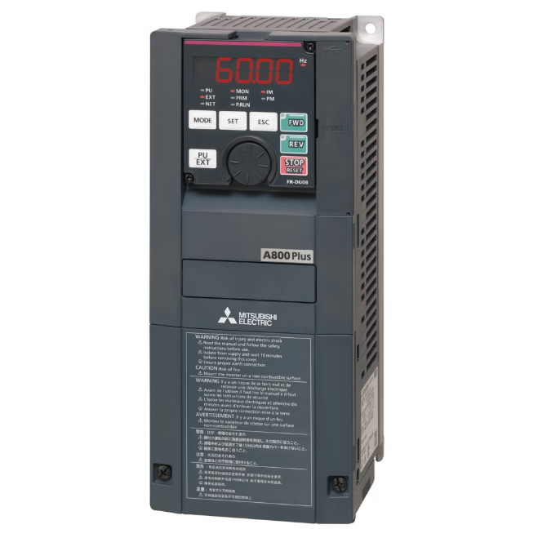
VFD migration (From Mitsubishi A560 – A860)
Scope of work
Procure replacement VFD, option cards and pull-down resistor pack for 22-2624 and 26-1213.
Mark up the conversion package (A560 to A860) drawing using the wiring and schematic diagram of the existing drawing.
Remove Mitsubishi a560 from service and Install a860 in service

Slide 10
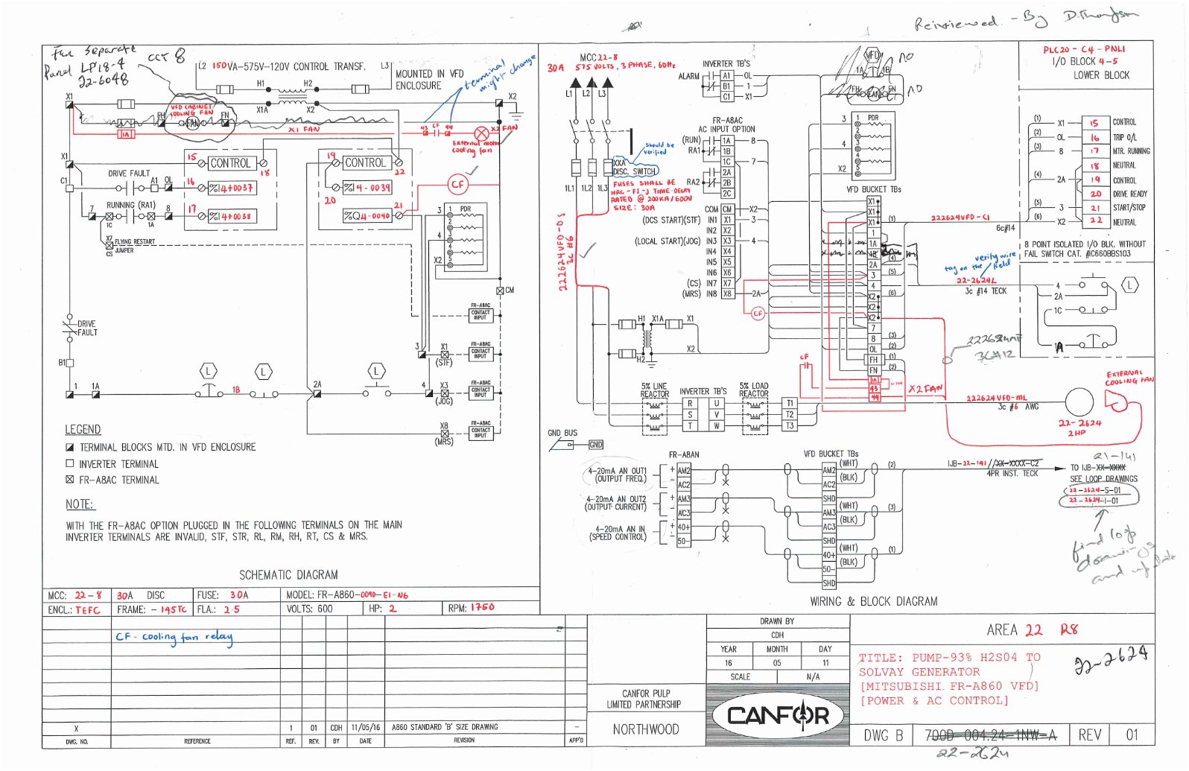
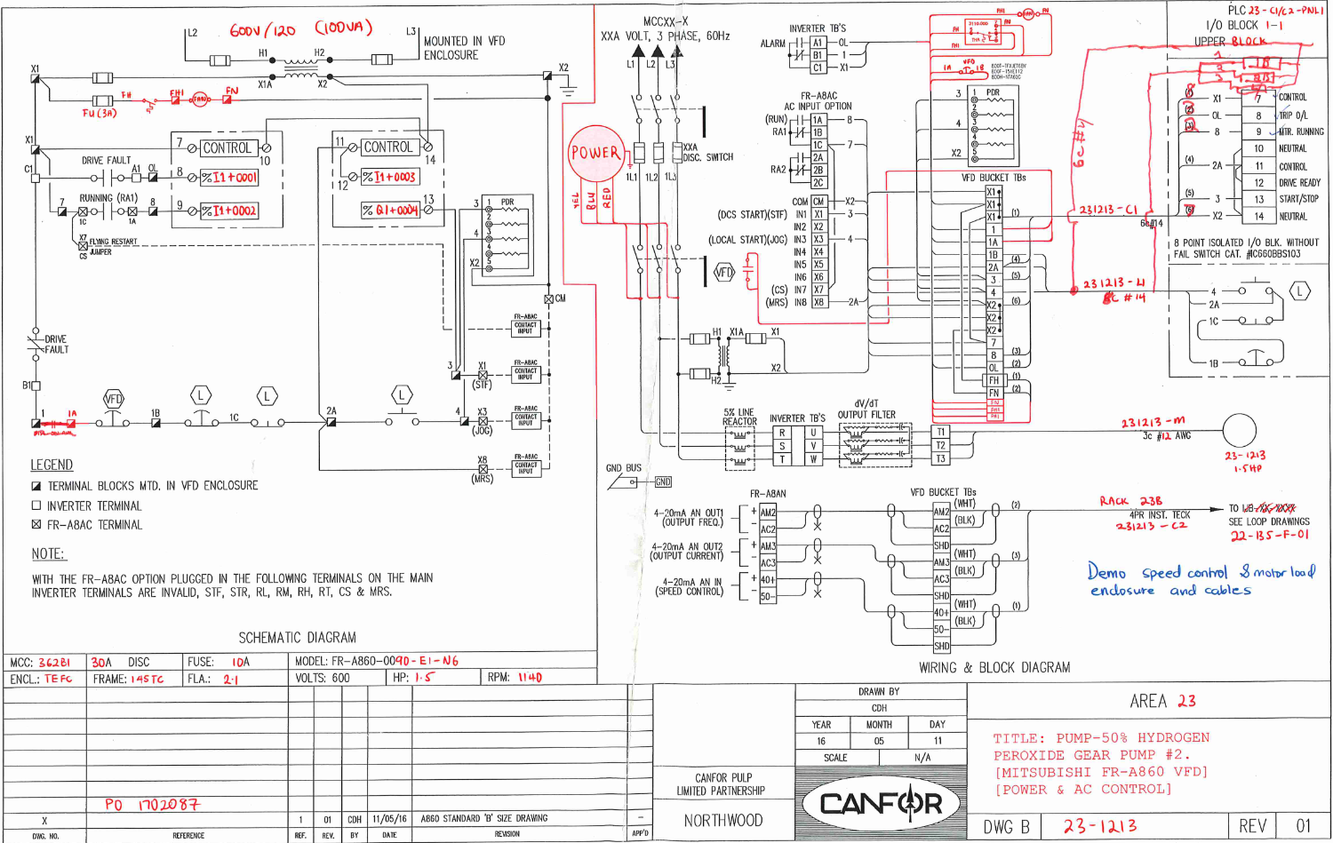
VFD migration (From Mitsubishi A560 – A860)
MARKED UP WIRING AND BLOCK DIAGRAM FOR POWER AND AC CONTROL FOR THE VFDs
22-2624: R8 93% H2S04
23-1213: B BLEACH 50% PEROXIDE

Slide 11
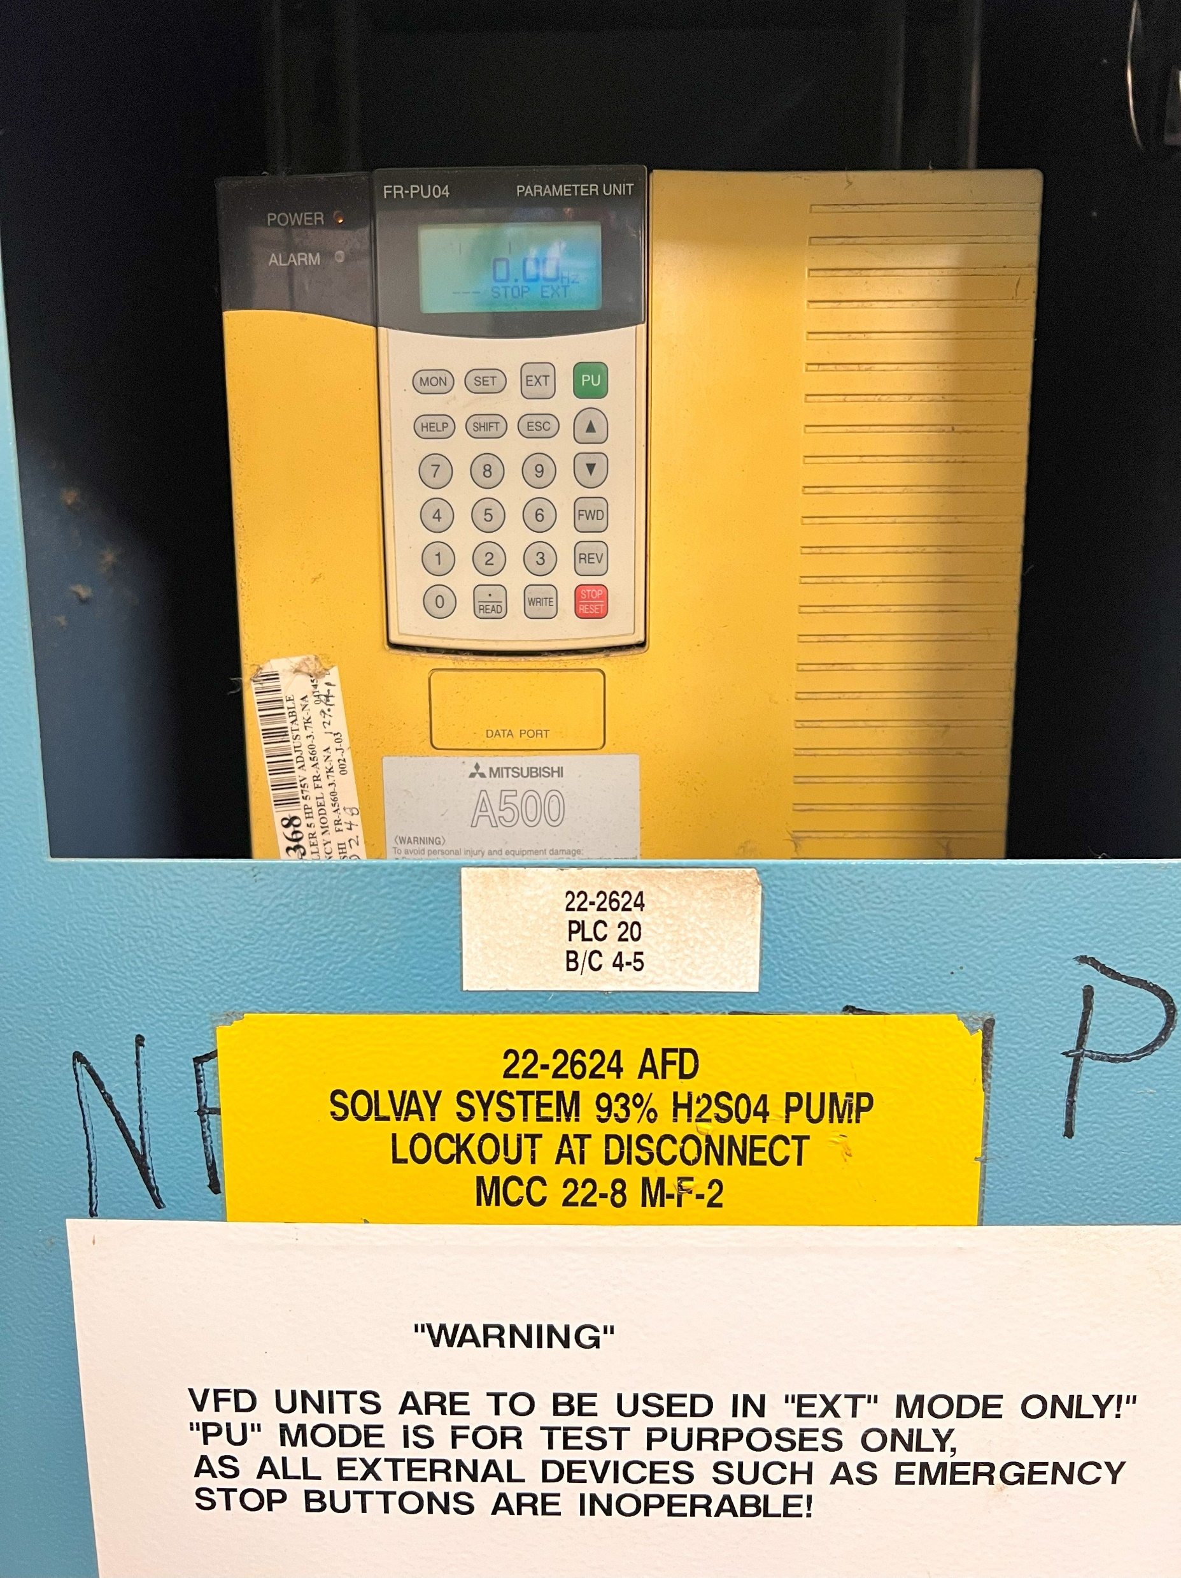
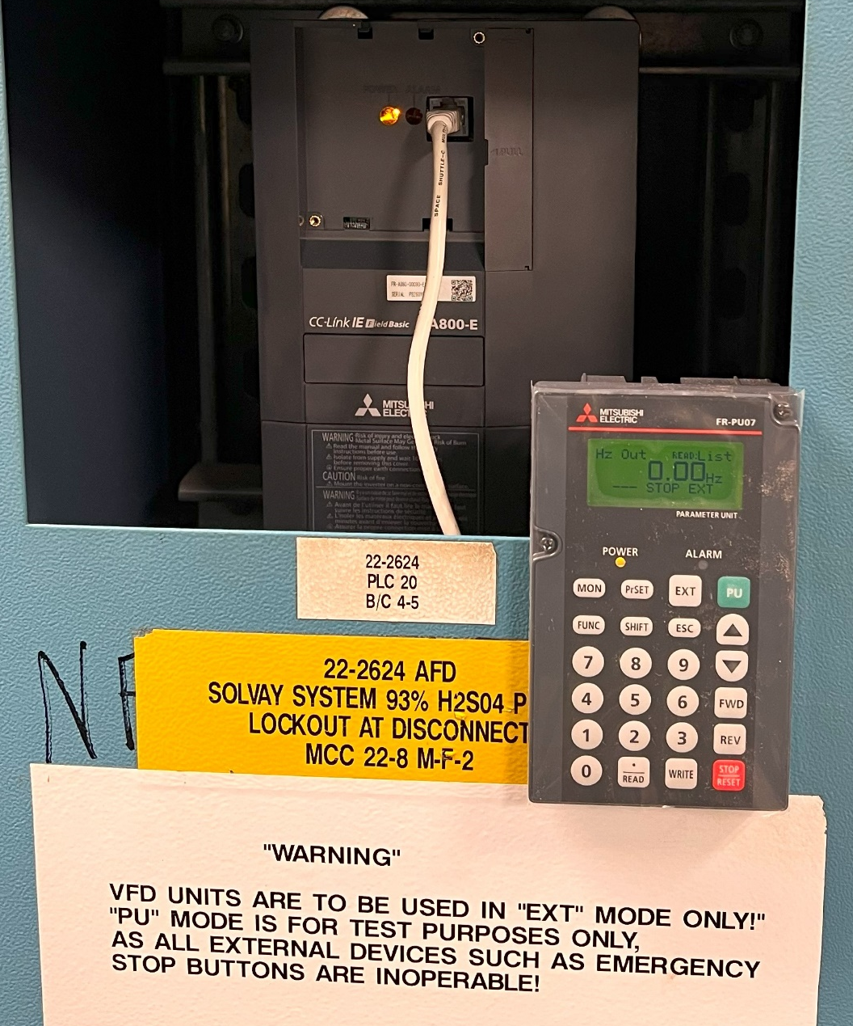
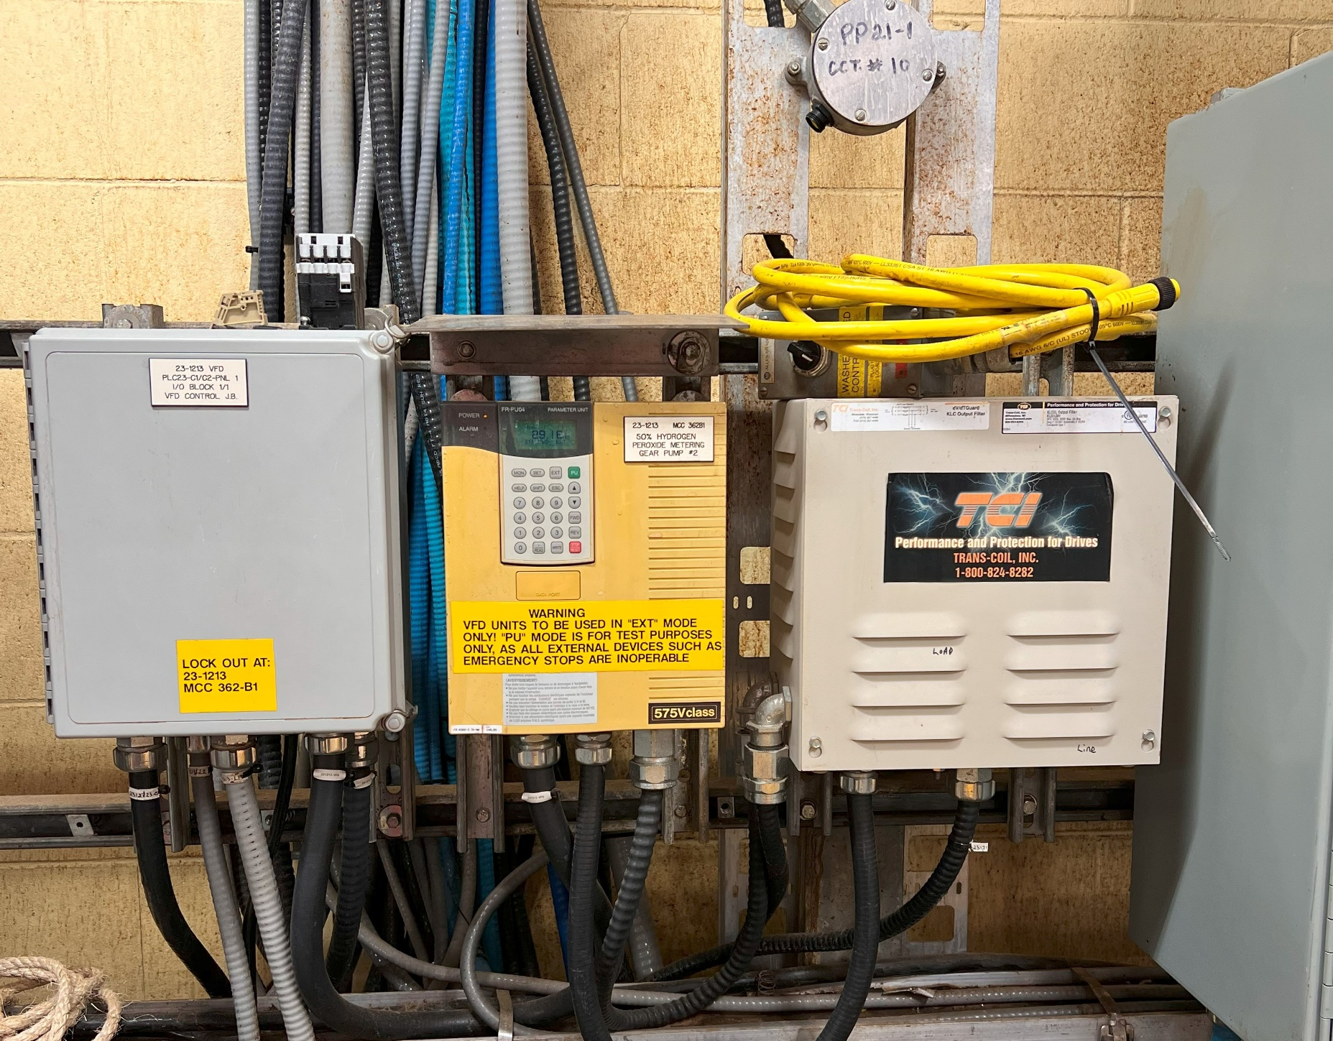
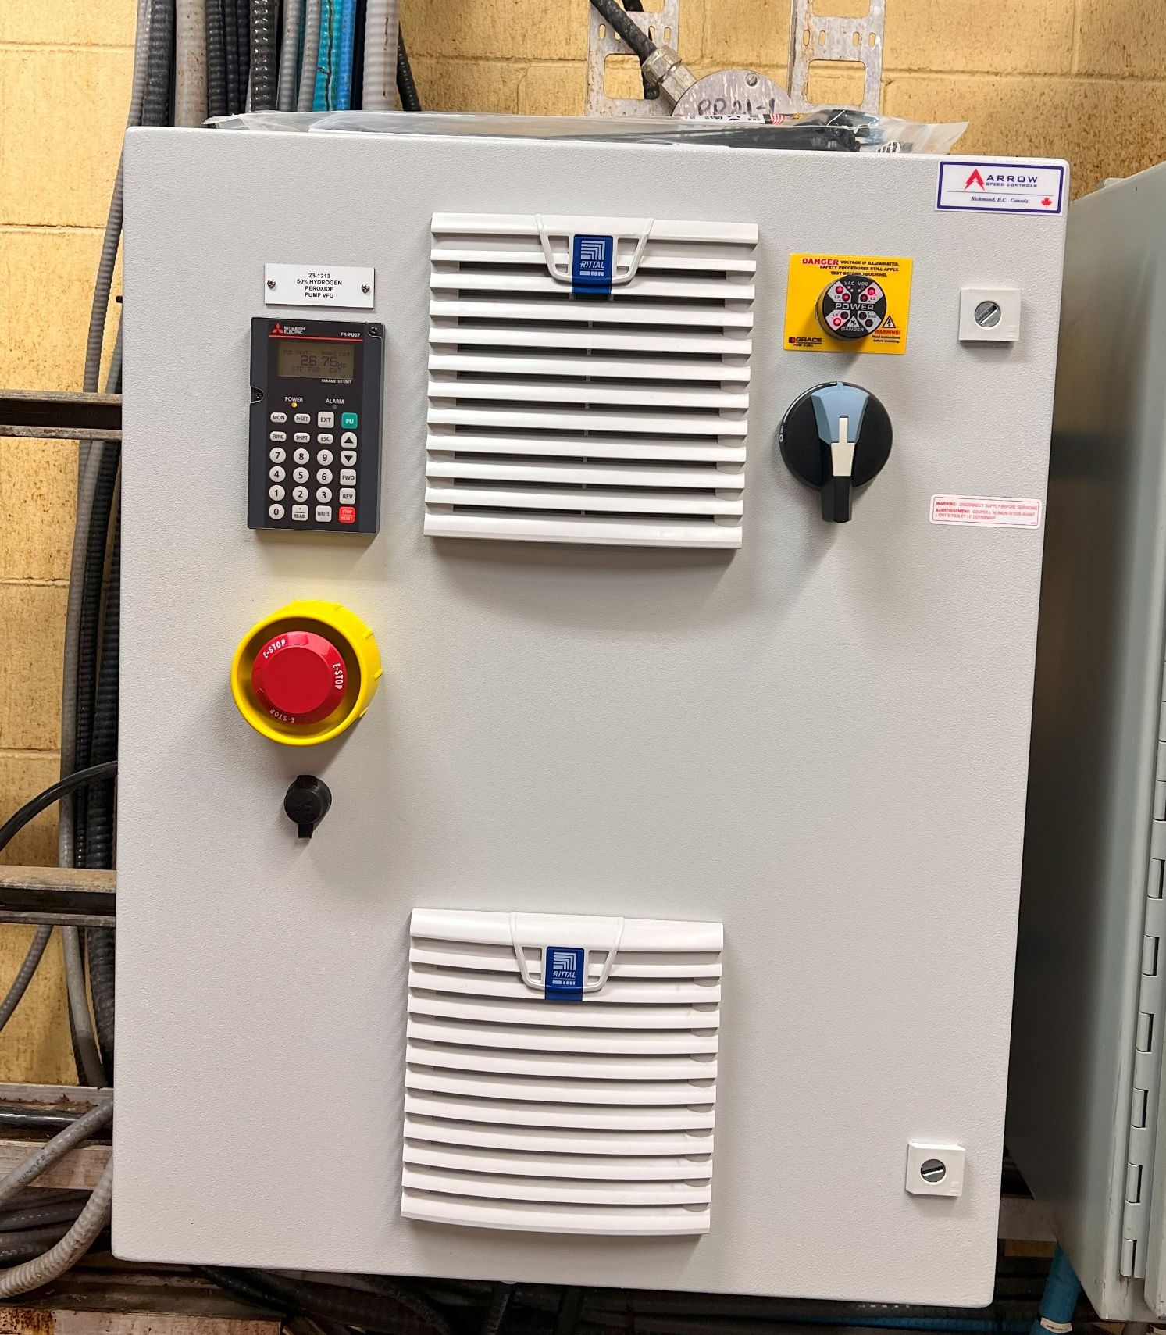
VFD migration – Results
OLD VFD SETUP
NEW VFD SETUP
OLD VFD SETUP
NEW VFD SETUP
R8 93% H2S04 PUMP VFD UPGRADE
B BLEACH 50% PEROXIDE PUMP VFD UPGRADE

Slide 12
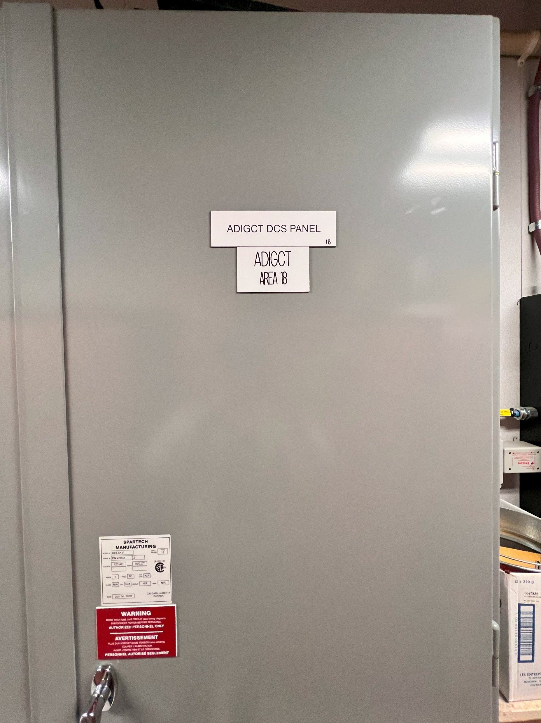
‘A’ Digestor Provox Migration Project
Scope of work
Rack Drawing Creation: Audit the marshaling racks with an instrument mechanic to collect conductor and cable tag information and create a rack drawing for Rack 18A and 18B, which has not been previously made.
I/O Points Audit: Input loop details into an Excel spreadsheet to create a master I/O list for loops in file 2 and cross-check the information with the drawing of each loop.
Mapping I/O and Updating Loop Sheets: Map old Provox I/O points to new points on the Delta V controller, and ensuring all new terminations are accurately updated and documented across over 100 instrumentation loop drawings related to File 2.

Slide 13
‘A’ Digestor Provox Migration Project
1
Visit the field with an instrument mechanic to collect information from the marshaling racks and create a comprehensive list for Rack 18A and 18B.
2
Document I/O List in a spreadsheet
4
Map old Provox I/O points in file 2 to new points on the Delta V controller,

Slide 14
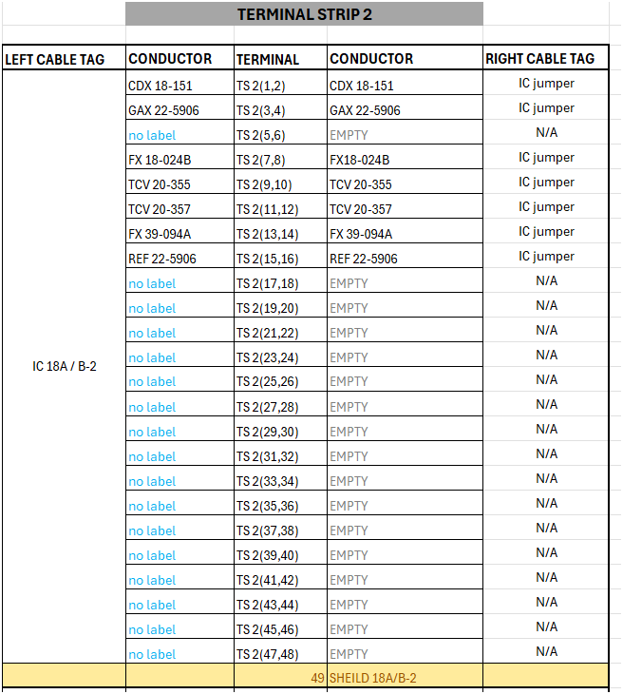
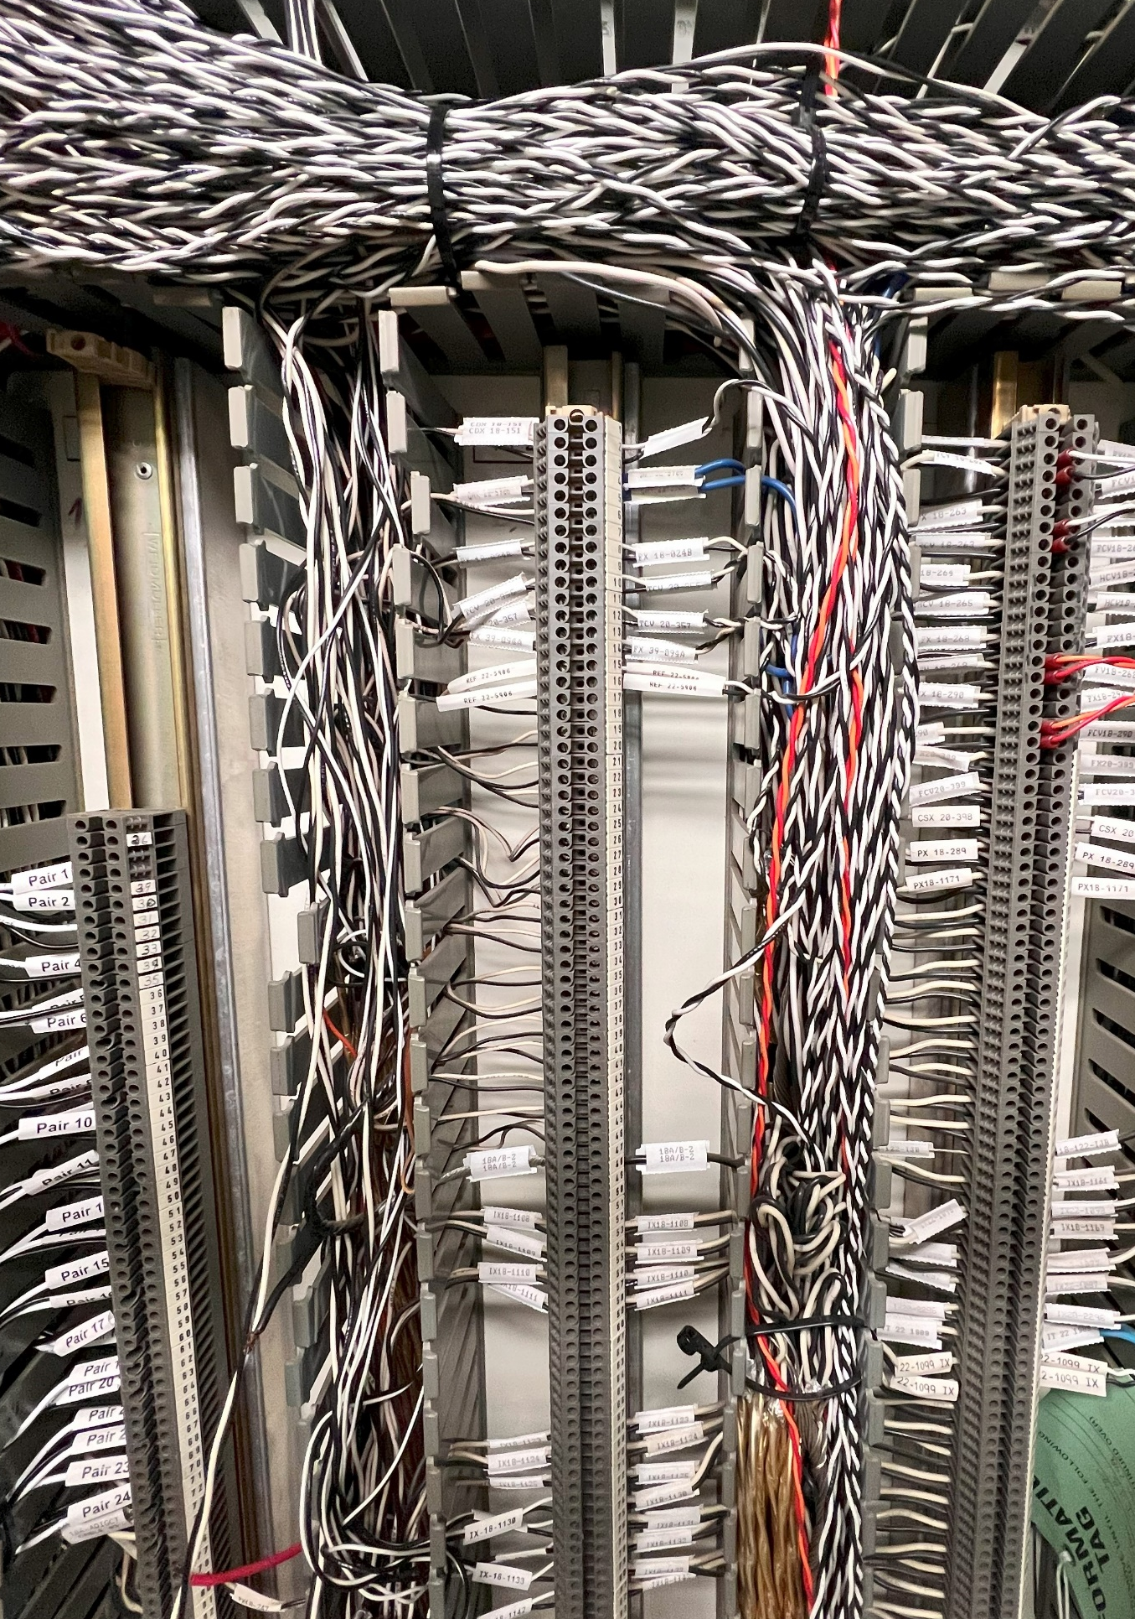
‘A’ Digestor Provox Migration Project

Slide 15
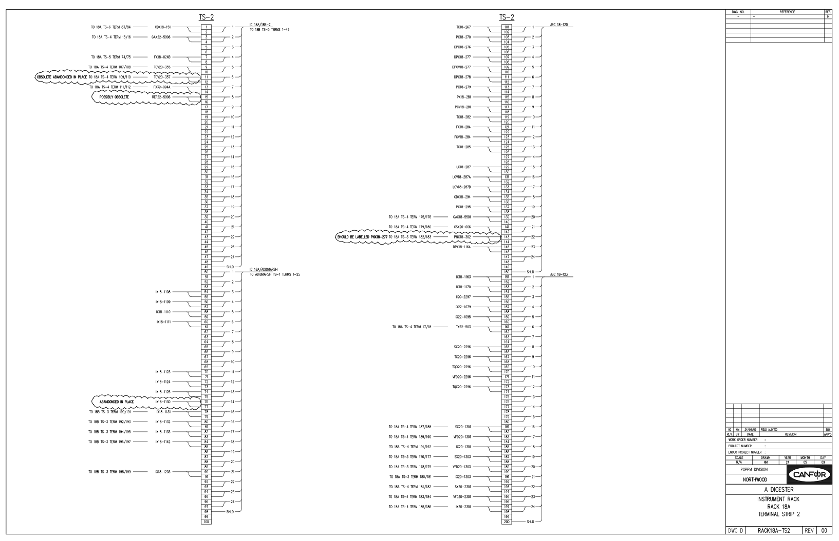
‘A’ Digestor Provox Migration Project

Slide 16
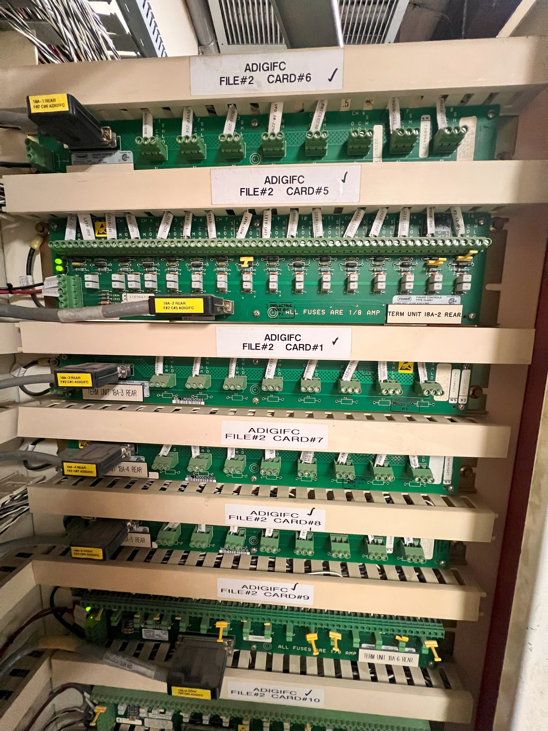
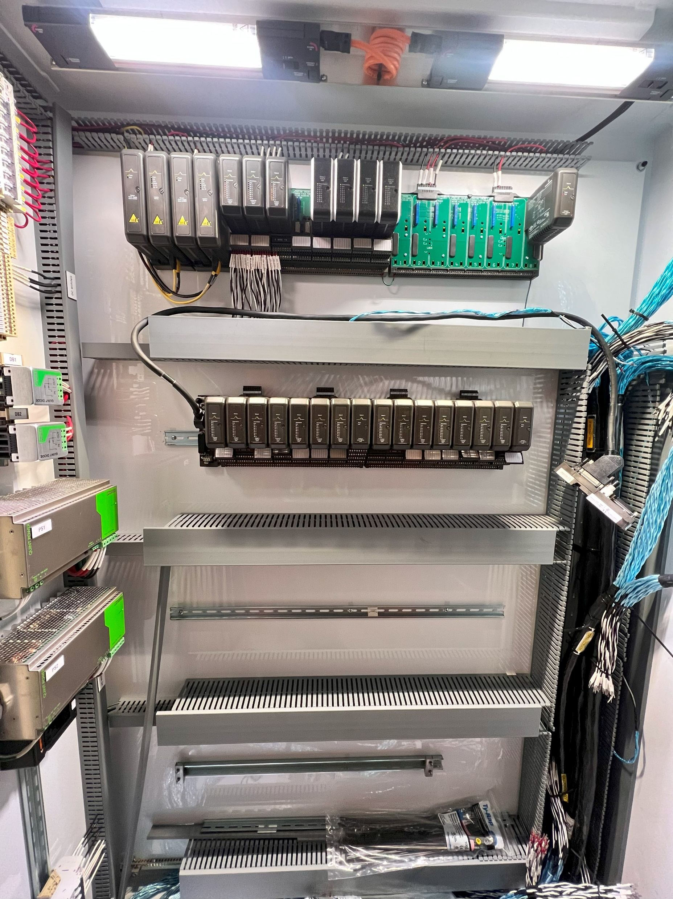
‘A’ Digestor Provox Migration Project
Provox controller (File 2)
Delta V M-Series Controller

Slide 17
Benefits to the mill
MCC/MCC Room Drawing Audits
Improved Emergency Preparedness
A-DIG Migration Project
Upgrading Obsolete asset
More stable operation
Distribution and Precipitator Transformer Summary Report
VFD migration for B Bleach 50% Peroxide Pump and R8 93% H2S04 Generator
Enhanced Maintenance Coordination
Proactive Maintenance Planning
Upgrade from Obsolete model
Cost Savings and Risk Management

Slide 18
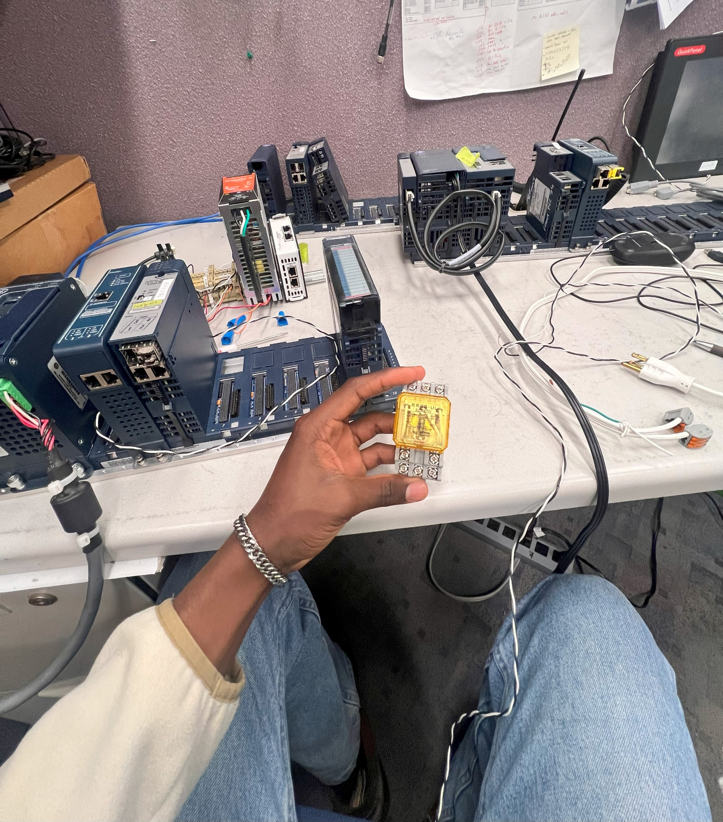
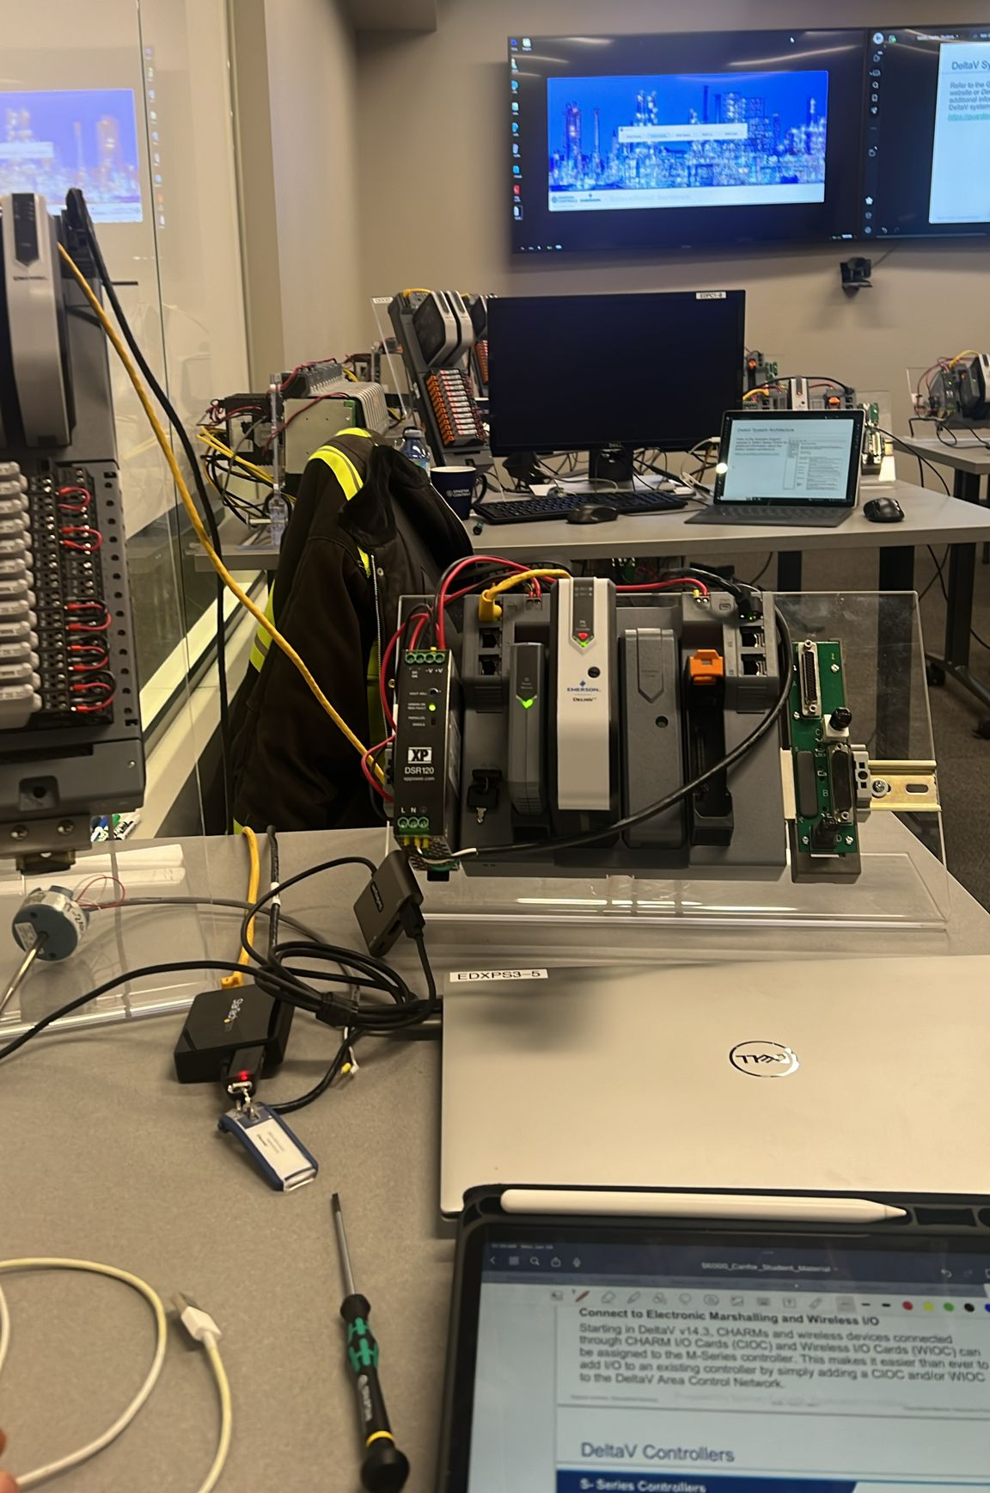
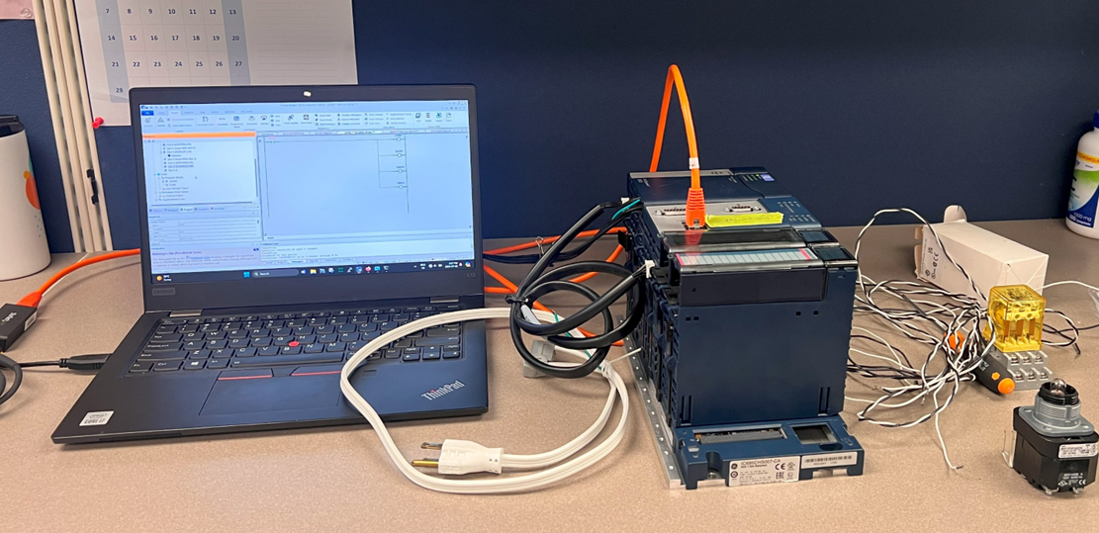
Supplementary – Workshops
Learning to basics of wiring a relay
Delta-V and AMS Training
Learning PLC Basics

Slide 19
THANK YOU!!

